Slide 1
The end of war in Europe

Slide 2
Timeline 1944
Jan – Soviet troops advance into Poland
March – Britain bombs Hamburg – 3,000 tonnes
May – Germany surrenders in the Crimea
June – D-Day. Allies enter Rome. First V-1 bomb hits London.
July – Soviets liberate the first concentration camp at Majdanek
August – Anne Frank and family arrested in Amsterdam. Allies invade Southern France. Paris is liberated.
September – US troops reach Siegfried Line in Germany
October – Last use of gas chambers at Auschwitz
December – Battle of the Bulge in Ardennes. Soviets besiege Budapest.

Slide 3
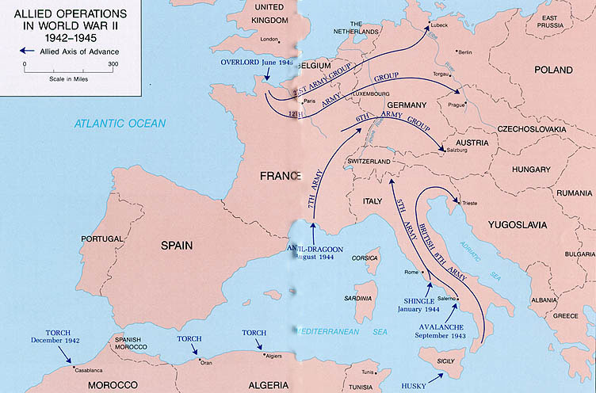
Allies gain a foothold
Notes:
Hyperlink the picture
Apocalypse Extract 6/6 – 2:55 to end
https://www.youtube.com/watch?v=aI-mXj0EBiQ

Slide 4
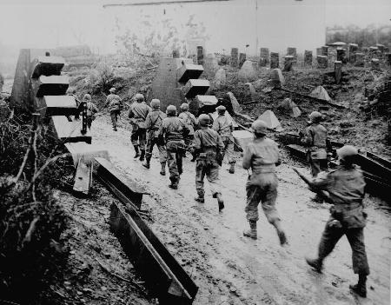
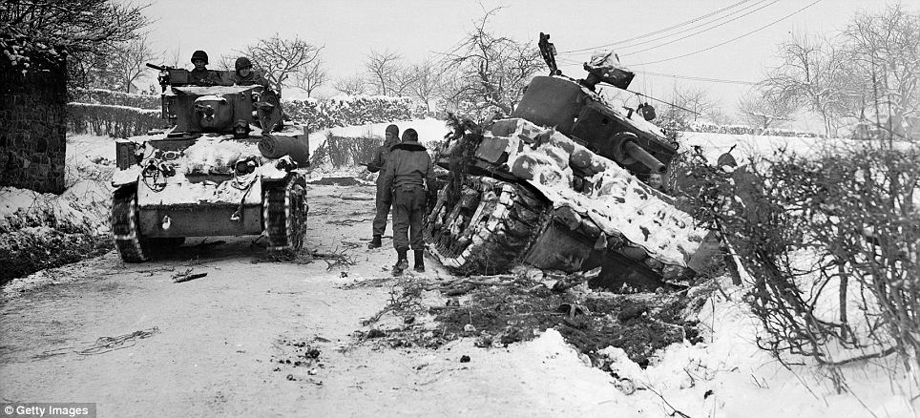

Slide 5
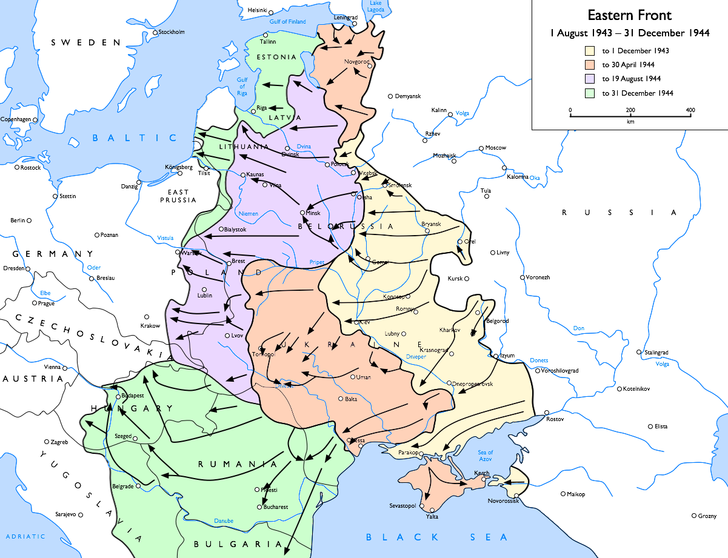
Russia Advance

Slide 6
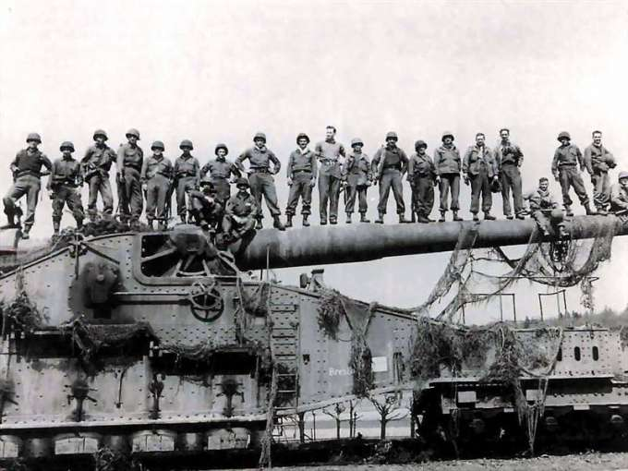
German resistance
Notes:
Hyperlink the image - Fury

Slide 7
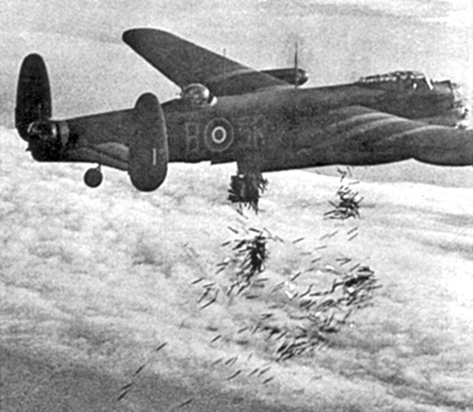
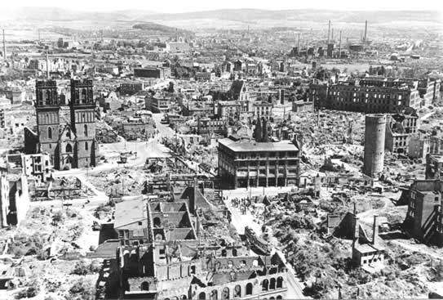
Bombing of Hamburg
July 24th – 15,000 killed in one hour
July 28th – 2,313 tonnes of bombs dropped in 50minutes which led to a firestorm with temperatures reaching 1000 degrees Celsius.
“Around us were hundreds of people. All this happened in silence. The terrible heat had dried throats so much that no one could scream.”

Slide 8
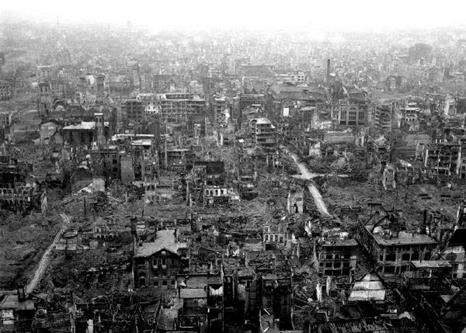
Bombing of Germany
Notes:
Hyperlink the picture
Bombs – 0:52 to 1:24

Slide 9
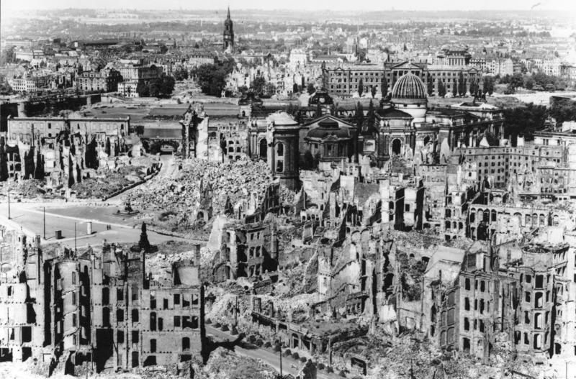
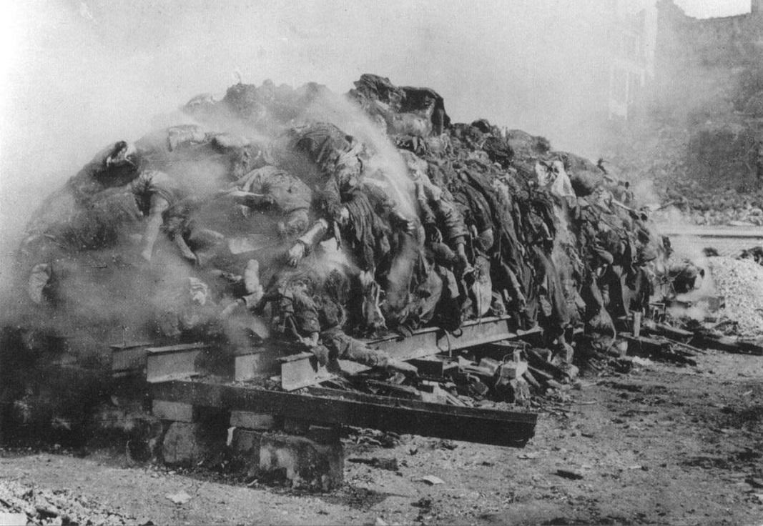
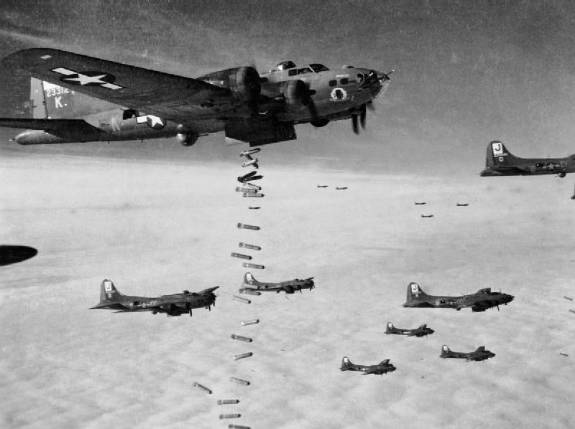

Slide 10
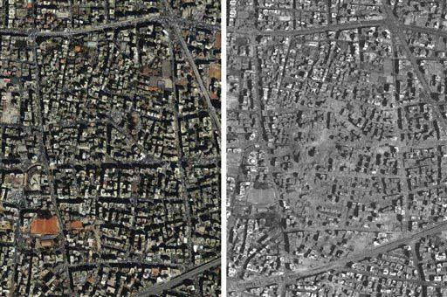
As a result of the German cities being bombed to near destruction, 300,000 Germans lost their lives and 800,000 were wounded.
Berlin was 70% destroyed and Dresden was 75% destroyed.

Slide 11
"We need to make the enemy burn and bleed in every way." Churchill in 1941
- "In spite of all that happened at Hamburg, bombing proved a comparatively humane method. For one thing, it saved the youth of this country and of our allies from being mown down by the military as it was in the war of 1914-1918.“ 'Bomber' Harris writing in his memoirs in 1947.
Question:
Referencing the two quotes and the image, to what extent do you agree or disagree with the bombing of German cities from 1943 to 1945?

Slide 12
Timeline 1945
Jan – Soviets capture Warsaw and liberate Auschwitz
Feb – Dresden is completely destroyed by firebombs
March – Soviets capture Danzig
April – Nazi’s spoils of war discovered in salt mines
April 1 – Allies encircle Germans in the Ruhr
April 21 – Soviets reach Berlin
April 28 – Mussolini captured and hung
April 29 – US liberate Dachau
April 30 – Hitler commits suicide
May 7 – Germany accepts unconditional surrender
May 8 – V-E (Victory in Europe) Day
June – Allies divide Germany and Berlin, take over Government and UN charter is signed.

Slide 13
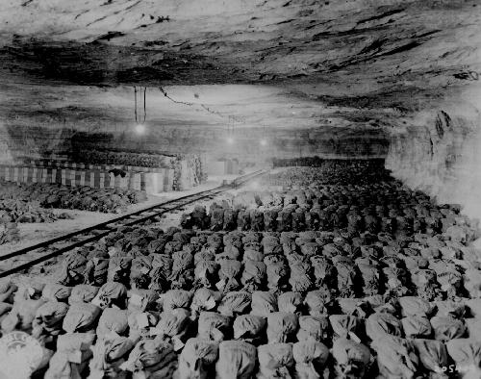
Nazi’s spoils of war
Notes:
Hyperlink the picture
Monuments Men movie
https://www.youtube.com/watch?v=CreneTs7sGs

Slide 14
Hitler commits Suicide
On April 30th 1945, Hitler committed suicide in his bunker in Berlin along with his mistress/wife Eva Braun. Hitler waited until the very last minute as the Russian army was enclosing in on Berlin and his bunker.
His remains were burned and taken back to Russia where they weren’t seen until 1970 when they were cremated and his ashes scattered.
The bunker location is now a parking lot and only since 2006 has it being marked as the official location.

Slide 15
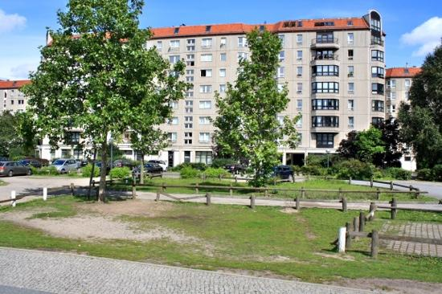
The site of Hitler’s bunker today
Russian soldier in Hitler’s bunker in 1945

Slide 16
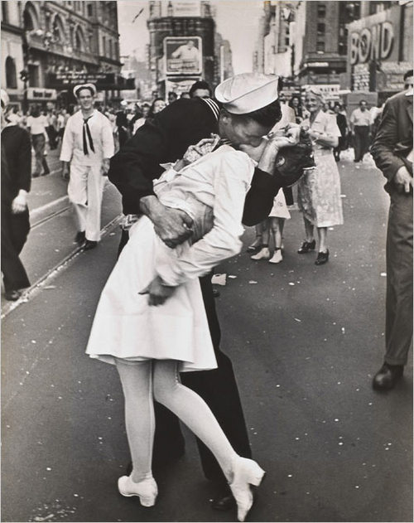
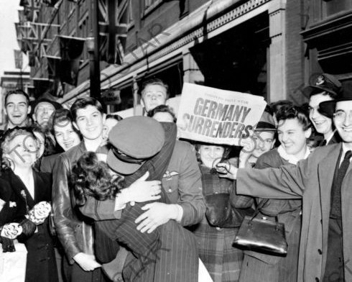
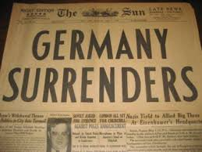
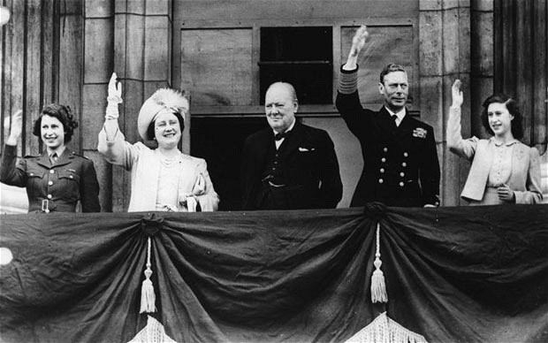
V-E Day
May 7th – Germany surrenders.
May 8th – V-E Day
Notes:
Hyperlink Royalty photo
Churchill speech – German surrender
https://www.youtube.com/watch?v=efvwJjzqKUk

Slide 17
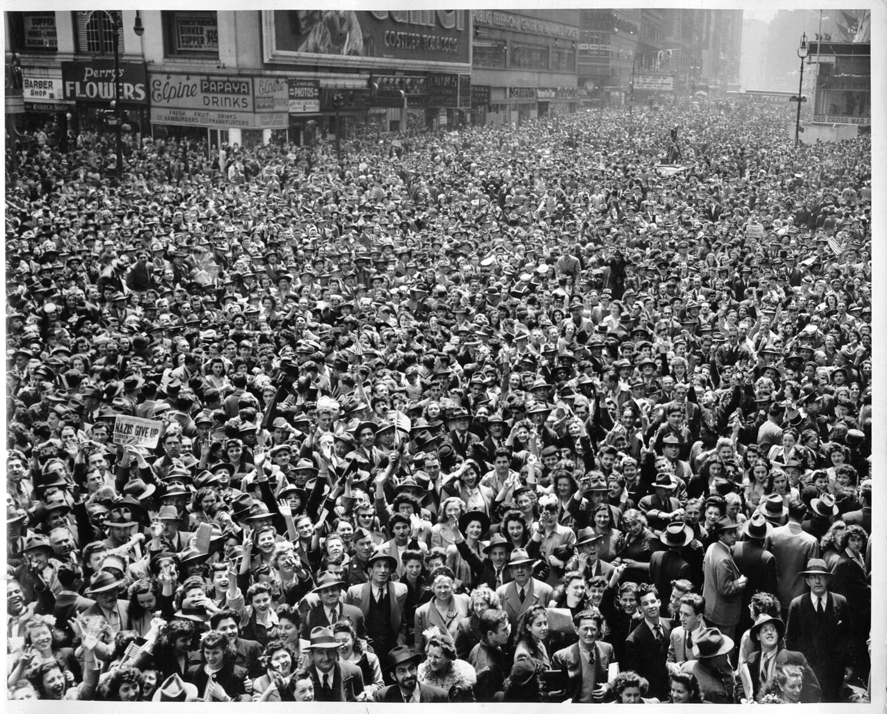
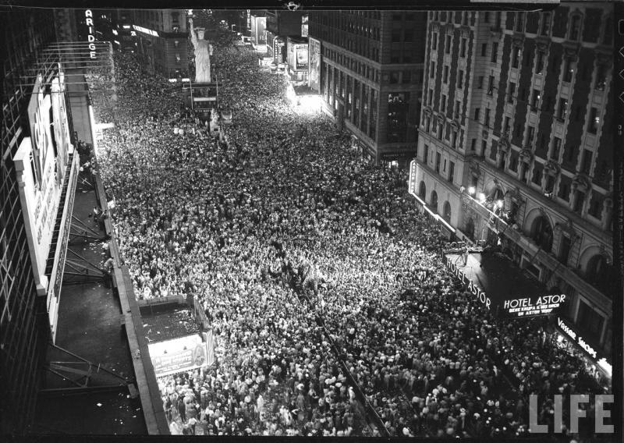
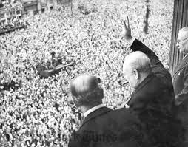
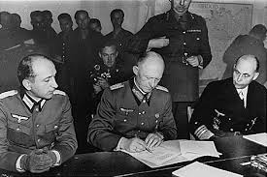

Slide 18
Resources
Fury – movie – Allied forces are pushing further into Germany and a tank commander tries to keep his crew alive throughout the heat of the battle.
The Book Thief – movie – Offers a perspective from a young German during the final days of World War II.
This website talks about the ethical use of bombs on German cities - http://www.historylearningsite.co.uk/bombing_world_war_two.htm
Band of Brothers – mini-series – Much of the series takes place throughout Western Europe as the Allies push the Germans back. This clip shows Easy Company taking a town against heavy German resistance – Cpt Speirs. https://www.youtube.com/watch?v=R6da9U6Xjd8
Monuments Men – movie – US Professors and Historians aim to find the German loot of European treasures.

