Slide 1
Holocaust
Resources
History Alive 10
Oxford Big Ideas 10
Film Schindler’s List

Slide 2
Terms and ideas 1
What is the Holocaust?
A unique form of genocide
The term means sacrificed by fire/burnt. Why?
Caused by anti-Semitism
The term in Hebrew is the Shoah which means catastrophe as half of all the Jews of Europe were wiped out.
Anti-Semitism was rife in Germany from 1933-1945, not just the dates of WWII – 1939-1945.

Slide 3
Terms and ideas 2
What is a genocide? The deliberate attempt to wipe out a religious, racial or ethnic group
What is anti-Semitism? Hatred of Jews
What are Jews? An ethnic group that may be characterised as having a common history, religion, language, ancestry, styles of dress, customs, festivals, celebrations, food, a feeling of ‘homeland’ associated with Israel.

Slide 4
Terms and ideas 3
Ghetto’s
Ghetto’s are small areas used to isolate Jews from the rest of the population. They were bricked off or encircled with barbed wire and heavily guarded to prevent escape. Ghetto conditions were brutal, crowded, had no running water/toilets. Very low rations meant 80,000 died of malnutrition, disease, forced labour and shootings

Slide 5
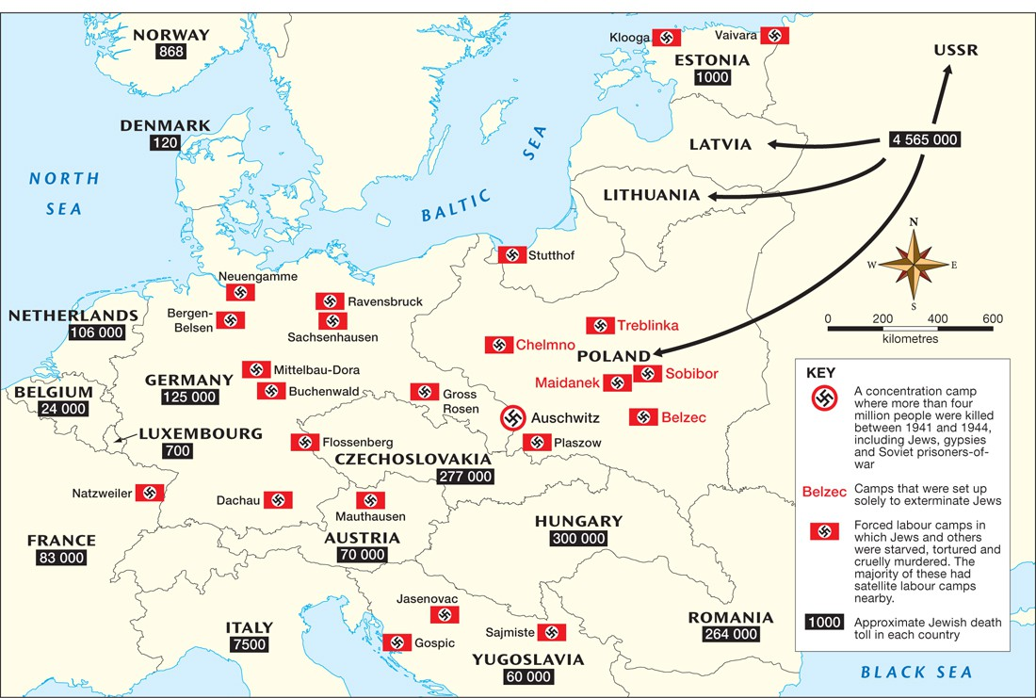

Slide 6
Timeline 1
Hitler developed his ideas of nationalism early and joined the German army in 1914
1919 Hitler joined the German workers political party and in 1921 he led the party and changed its name to NAZI
1923 Mein Kampf (My Struggle) ‘The personification of the devil as the symbol of evil assumes the living shape of the Jew’. Jews were a threat and scapegoat to the Aryan dream of a German master race destined to rule the world.
Boycott of Jewish businesses, business ownership transferred from Jew to a non Jewish German, refusal of German citizenship to German Jews, removal of Jews from jobs in government, law, universities, the military.

Slide 7
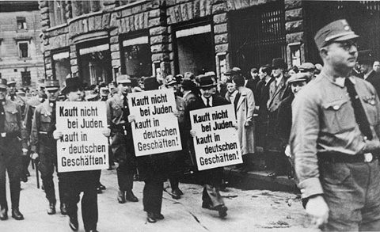
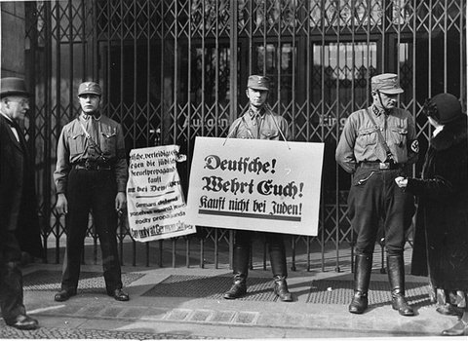
Jewish Shops
Nazis force three Jewish businessmen to march down Bruehl Strasse, one of the main commercial streets in central Leipzig, carrying signs that read: "Don't buy from Jews; Shop in German businesses!“
"Germans, defend yourselves against the Jewish atrocity propaganda, buy only at German shops!" and "Germans, defend yourselves, buy only at German shops!“

Slide 8
Timeline 2
Nuremberg laws enacted against the Jews.
Law for the compulsory sterilization of mentally and physically disabled.
400,000 were sterilised and 5000 die from the operation.
70,000 were killed in the euthanasia program using lethal injection or shooting.
Removal of Jews from public schools. Jews to not enter public places including parks, transport, swimming pools, movies. Jews to wear a star of David on outer garment.
Many Jews left Germany
Nov 9-10 1938 Kristallnacht Night of Broken Glass. Attacks on Jewish homes, businesses, synagogues in Germany and Austria

Slide 9
Jewish Heritage Chart

Slide 10
Timeline 3
1939 Poland invaded and WW2 begins. Nazis establish ghettos and concentration camps in the occupied countries.
After the invasion of the Soviet Union in 1941 there were mass executions of Jews by Einsatzgruppen (mobile killing units), Wehrmacht and local collaborators
Jan 1942 the Final Solution – meaning deportation of Jews to labour camps. Their extermination and cremation would follow.
3 million Jews were murdered in this way.

Slide 11
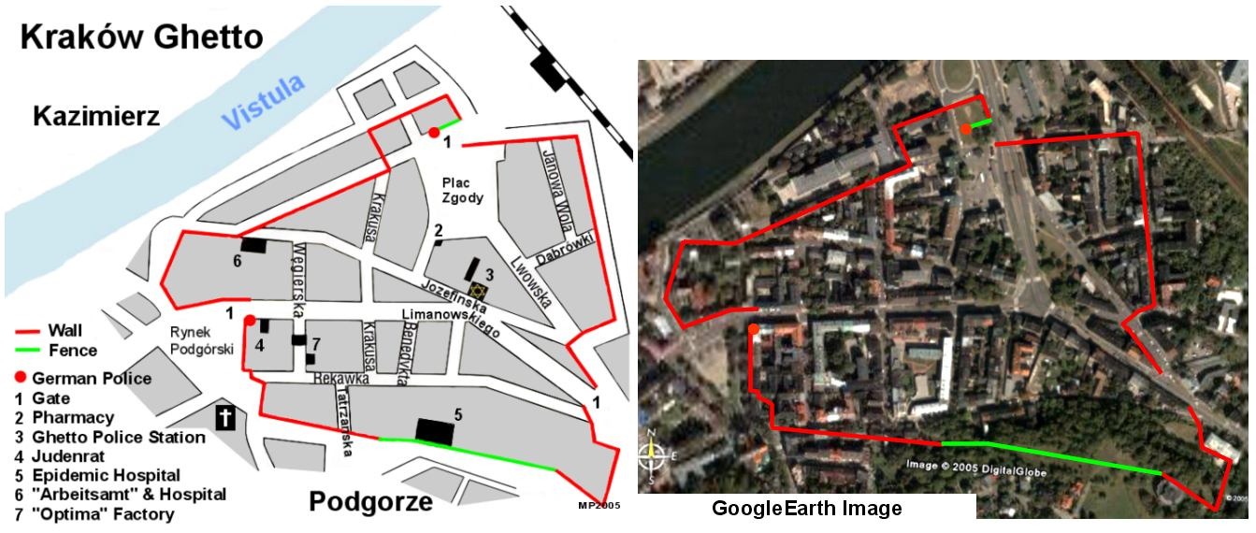
Krakow Ghetto

Slide 12
Timeline 4
Another 3 million Jews died outside the camps
Some Jews survived the camps. They survived living as partisans (freedom fighters) in the forests; lived under the radar by hiding with a changed identity; also often with the assistance of non Jewish help.
Of the 11 million Jews in Pre-War Europe, 6 million would be murdered by the end of 1945.
As the war started to turn against Hitler and the Nazi’s, they became more brutal and the killings increased.

Slide 13
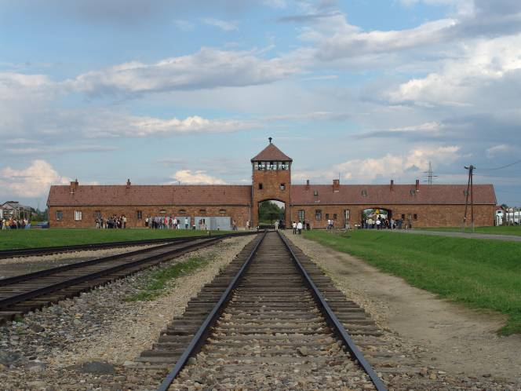
Auschwitz Death Camp, Poland
The infamous train station at Auschwitz Death Camp

Slide 16
These are burned down barracks where the Nazis again tried to destroy evidence of atrocities in the Auschwitz camp.

Slide 18
Post war
How do we remember these events?
War crime trials
Establishment of Holocaust museums and memorials
Memoirs and films
Establishment of United Nations
Establishment of Israel (Jewish homeland)
Declaration of Human Rights (every human should have basic human rights)

Slide 19
Holocaust Memorial - Berlin
5 Acres in size = 3 soccer fields side by side
Over 27,000 concrete graves
All of different heights
Designed for personal interpretation
Memorial to all of those impacted by the Holocaust

Slide 20
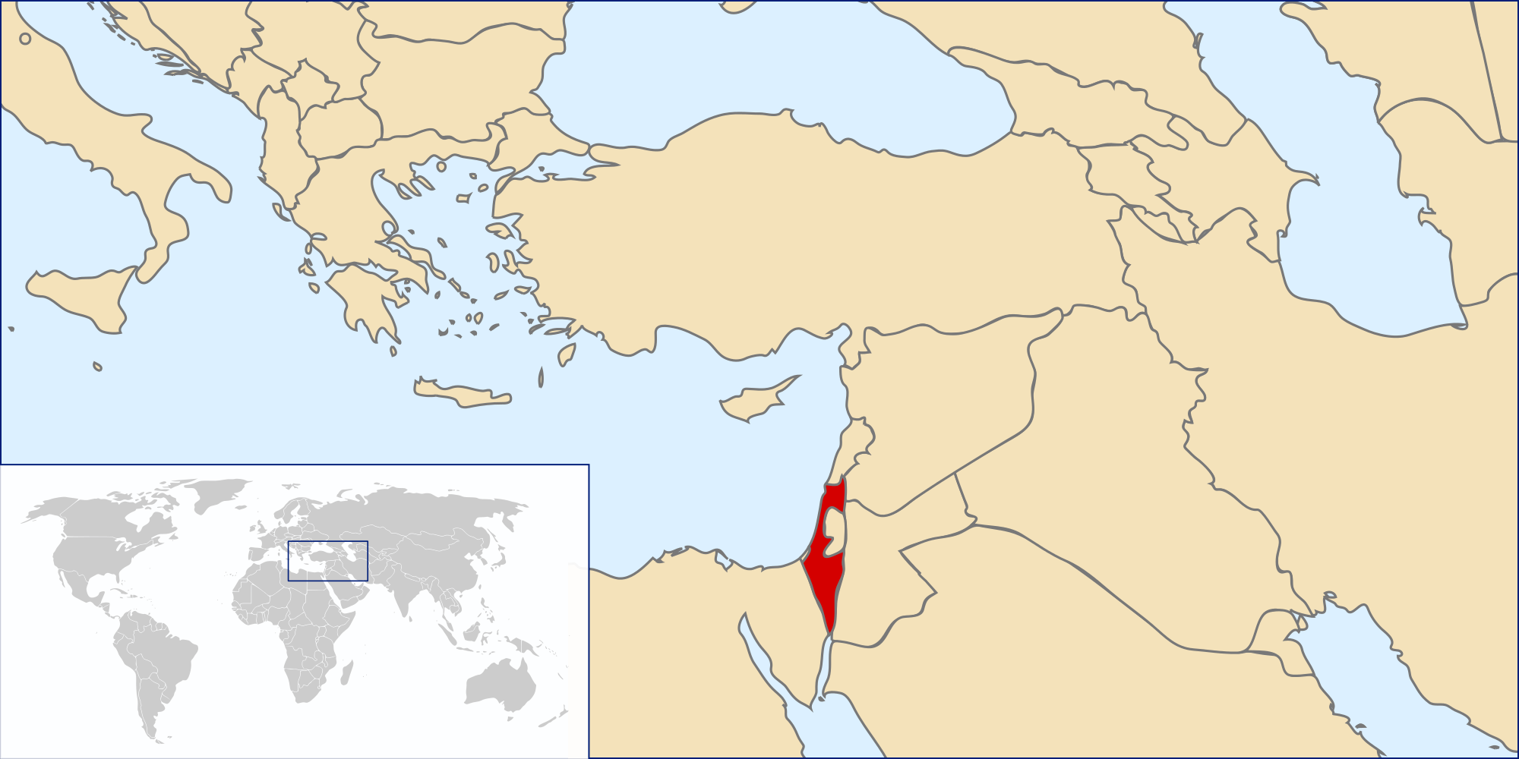
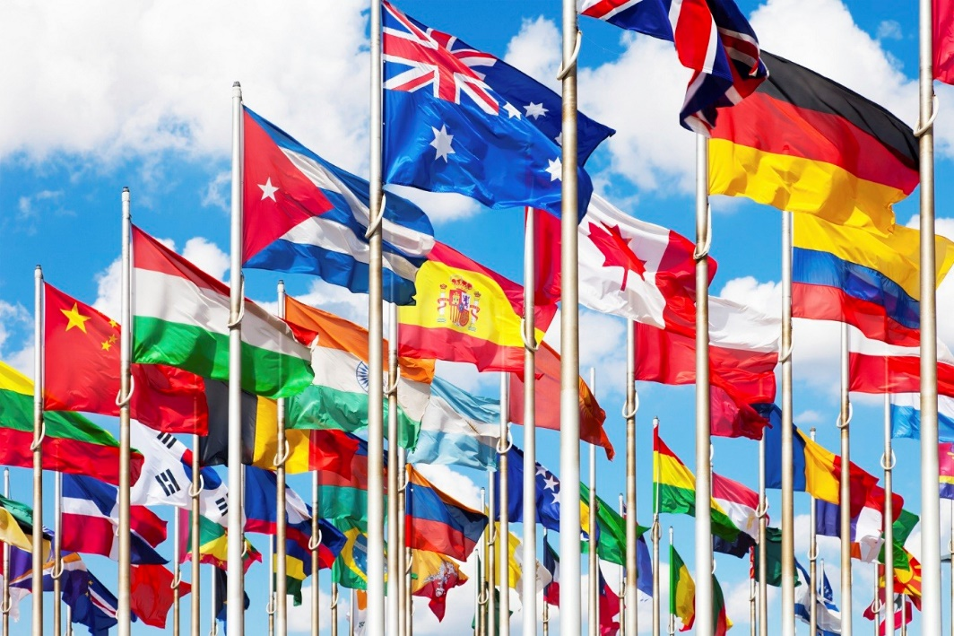

Slide 21
Activity 1 – Schindler’s List
After viewing the film. Make a list of examples of Nazi treatment of Jews and other peoples/groups. Discuss your list as class. (It takes very little time to fill the board with examples.)
“I hated the brutality, the sadism, and the insanity of Nazism. I just couldn’t stand by and see people destroyed. I did what I could, what I had to do, what my conscience told me I must do. That’s all there is to it. Really, nothing more.” Oskar Schindler
Discuss how this quote relates to scenes in the film.

Slide 22
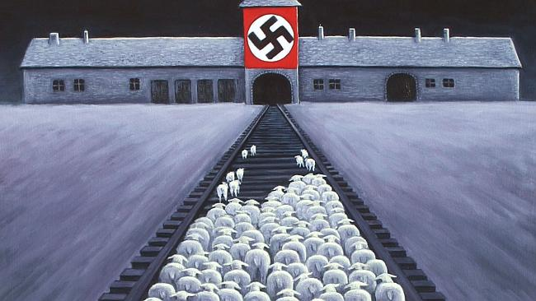
Activity 2 - Holocaust Analysis
Question – What is this drawing telling us about the Jewish Holocaust?
1. Answer the question
2. Use source detail (talk about details within the image)
3. Apply contextual knowledge (how does this image relate to your knowledge the Holocaust)

