Slide 1
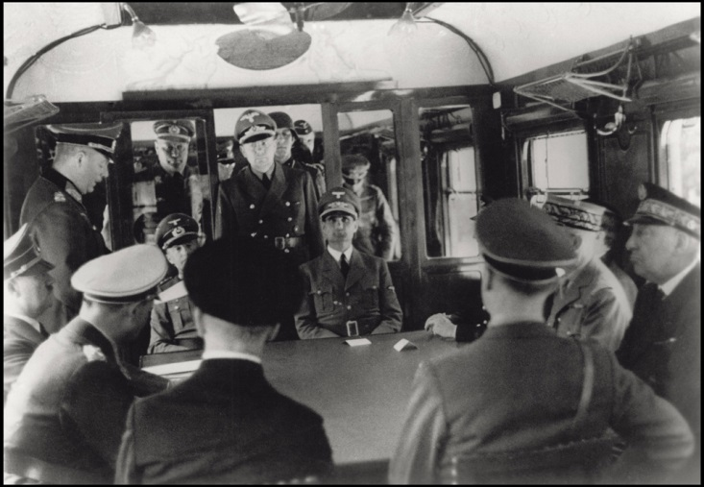
France surrenders – June 22nd 1940
“It is with a heavy heart that I tell you today that we must stop fighting”
Marshall Petain

Slide 2
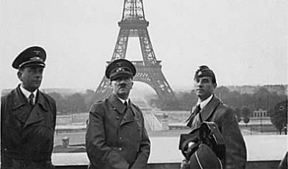
Hitler walks through Paris with the Eiffel Tower in the background

Slide 3
Under the terms of the armistice, two thirds of France is to be occupied by the Germans. The French army is to be disbanded. In addition, France must bear the cost of the German invasion.
France
1940-1942 1943 1944

Slide 4
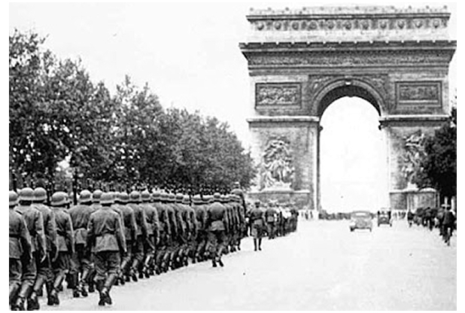
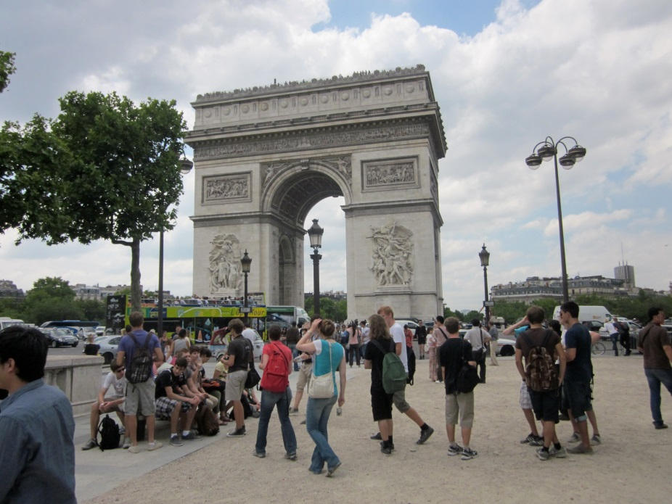
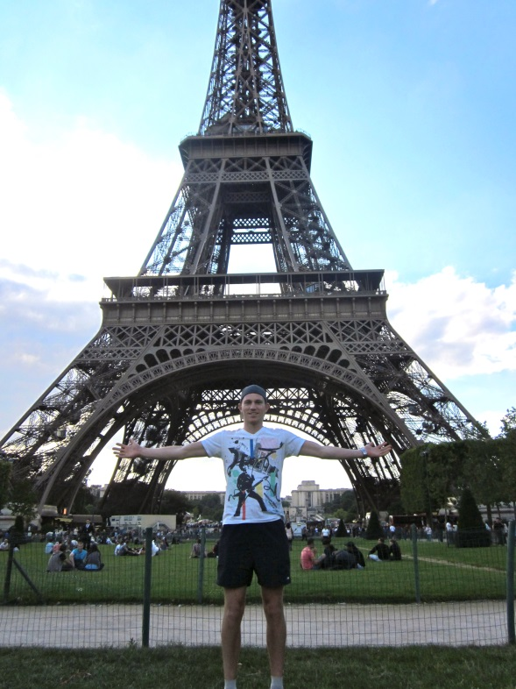
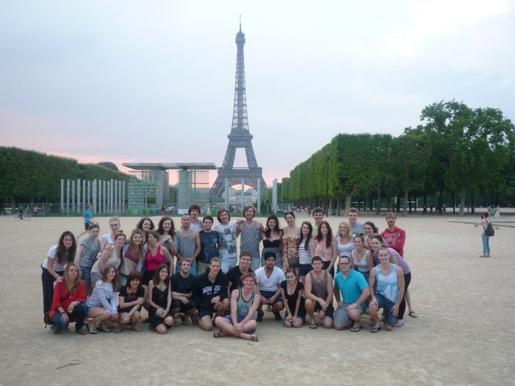

Slide 5
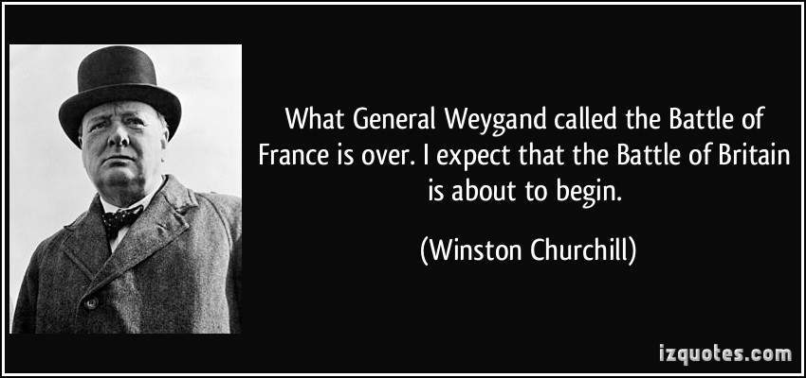
Winston Churchill’s speech – ‘Their finest hour’
Notes:
Hyperlink the title

