Slide 1
D-Day
June 6th 1944
“You are about to embark upon the Great Crusade, toward which we have striven these many months. The eyes of the world are upon you”

Slide 2
Timeline 1939 - 1942
1939 – World War II begins
1940 – France surrenders, evacuation of Dunkirk and Battle of Britain
1941 – Battle of Britain ends. Invasion of Russia begins. Japan bombs Pearl Harbor – USA enter the war
1942 – Germans advance into Russia. Battle of Stalingrad begins. USA supply troops to North Africa and England.

Slide 3
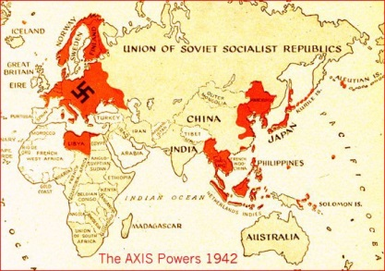

Slide 4
Timeline 1943
April - Germany withdraw from Tunisia.
May - Germany surrenders North Africa
July – Allies land in Sicily. Allies bomb Hamburg
September – Italy surrenders
November – Allies bomb Berlin
December – Stalin launches the offensive on the Eastern Front.
End of 1943 - Germany is being attacked through Italy, has lost out in Africa, is losing territory to the Russians and are on the retreat.

Slide 6
Hitler’s Fortress europe

Slide 7
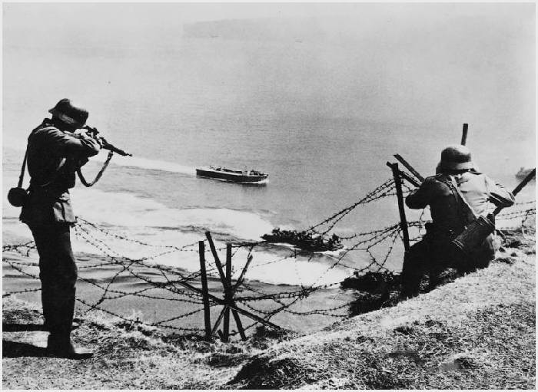
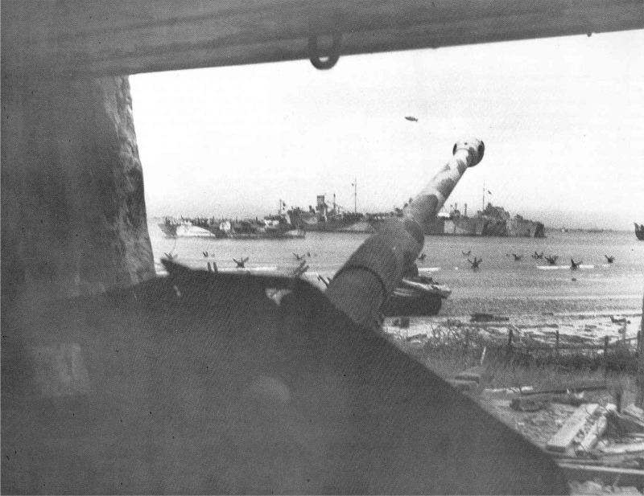
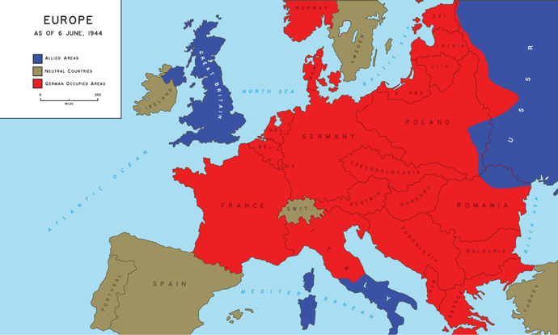
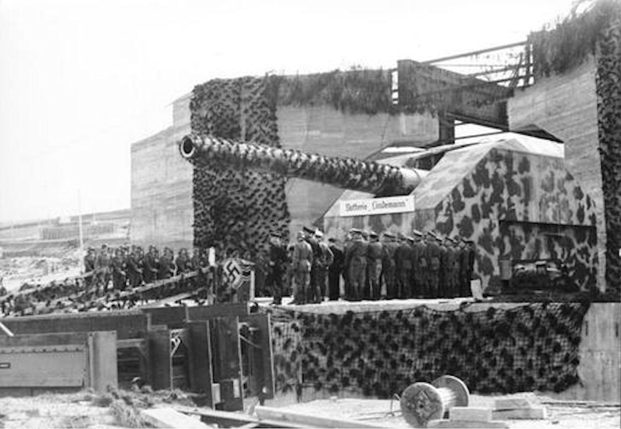

Slide 8
D-Day
The Normandy invasions have been called the beginning of the end of the war in Europe.
On June 6th 1944, 5,000 ships supported by 11,000 aircraft landed 156,000 American, British and Canadian forces on five beaches along a 50-mile stretch of heavily fortified coast of France’s Normandy region. 4,000 Allied soldiers lost their lives on D-Day – 2,000 of them American lives at Omaha beach.
The term D-Day refers to the day in which the landing in Europe will occur. D+3 would then mean D-Day plus 3 days.
Less than a week later, June 11, the beaches were secure and 326,000 troops had landed at Normandy. By the end of June the number was 850,000, and by the end of August Germany was pushed back into German territory and Paris had been liberated.

Slide 9
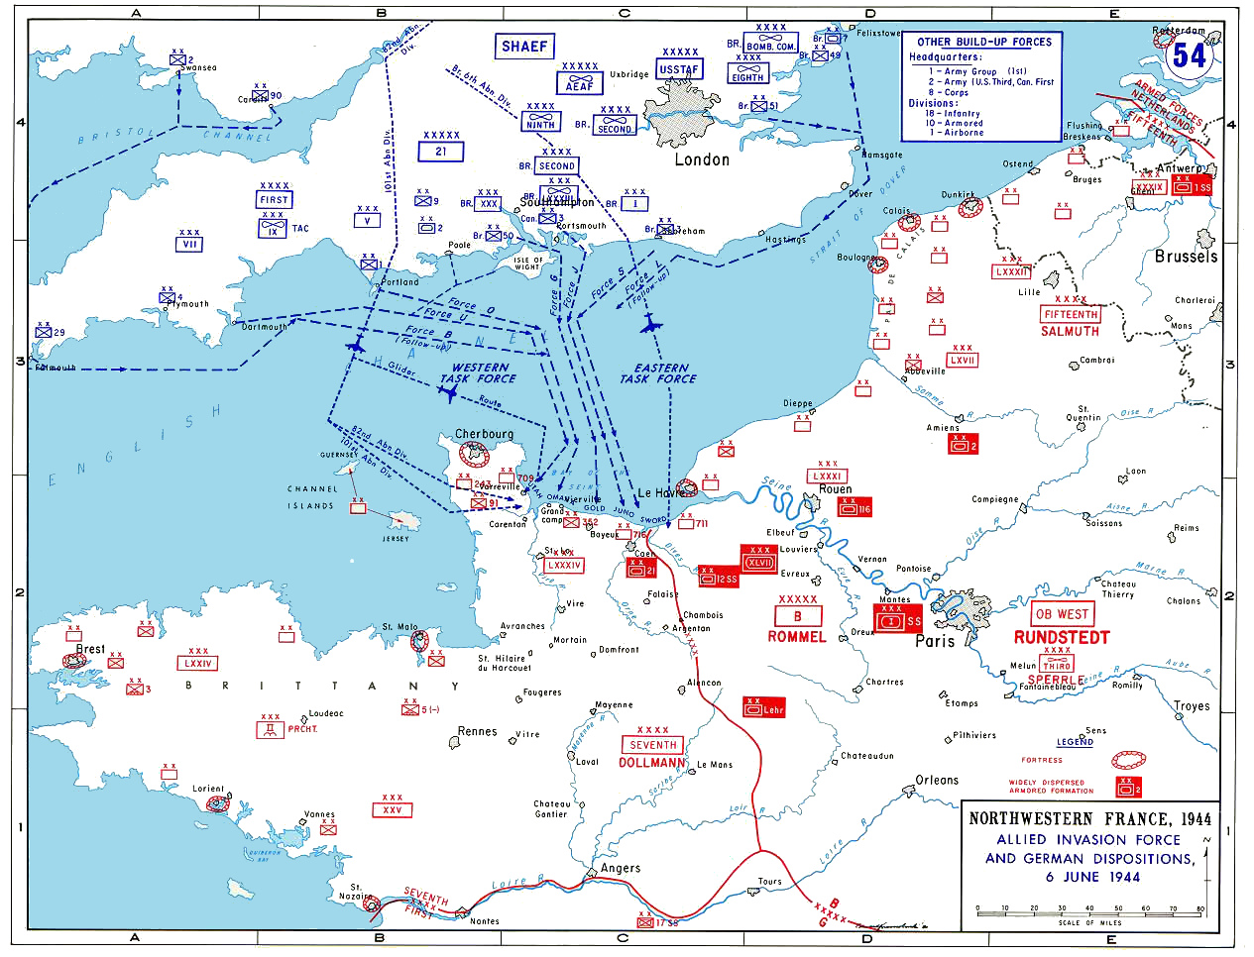

Slide 11
PARATROOPERS
Paratroopers are military parachutists — soldiers, marines, and others trained in parachuting into an operation and usually functioning as part of an airborne force.
On the morning of D-Day, before the Allies landed on the beaches,13,000 US Paratroopers were dropped over Normandy . What benefit would Paratroopers play in an invasion?
Notes:
Hyperlink the picture
Band of Brothers – Normandy invasion

Slide 13
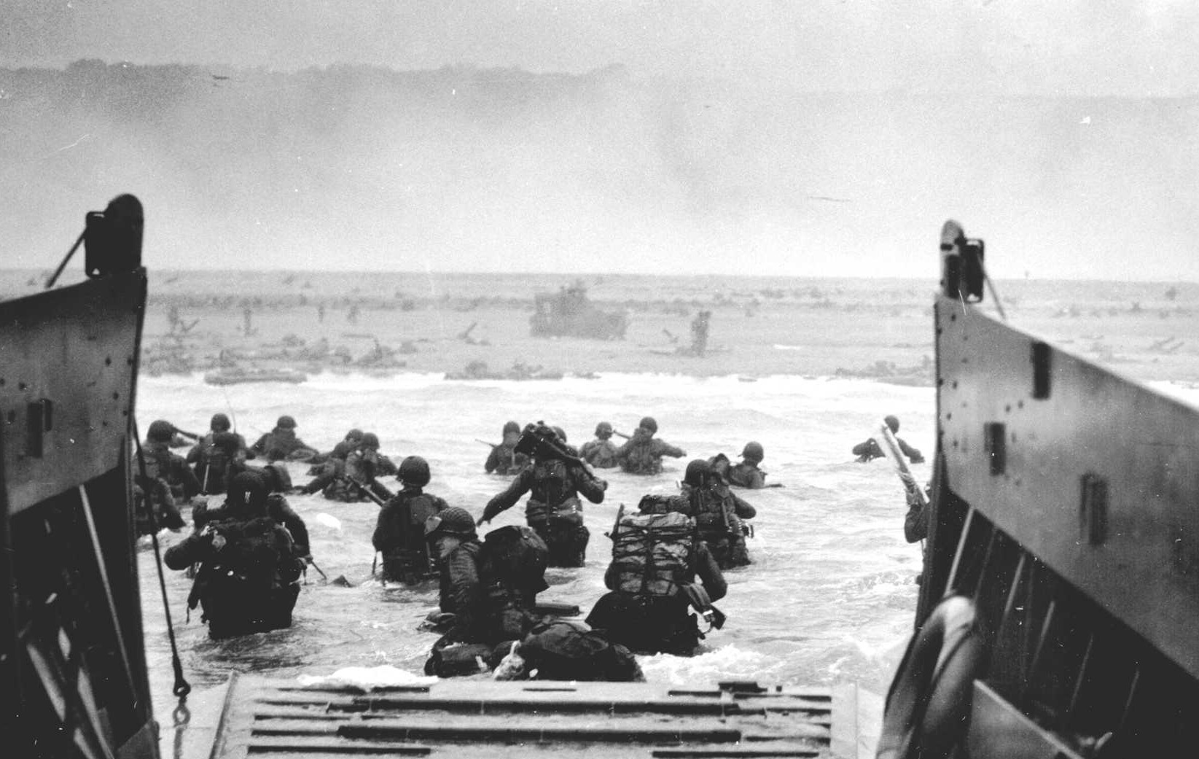
Notes:
Hyperlink the image
Saving Private Ryan beach scene

Slide 14
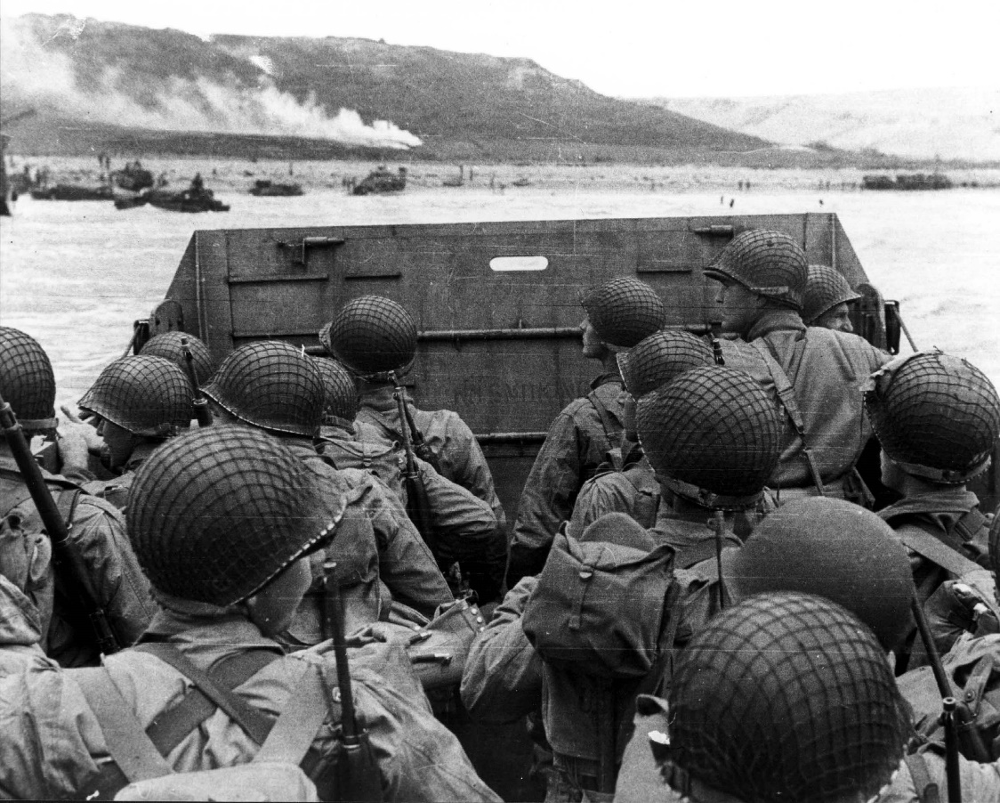
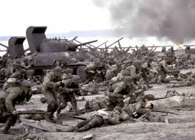
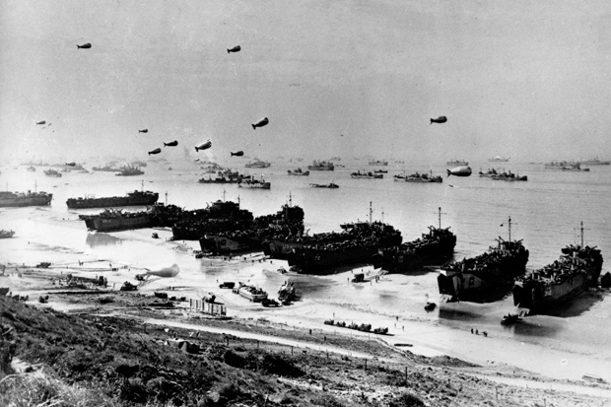
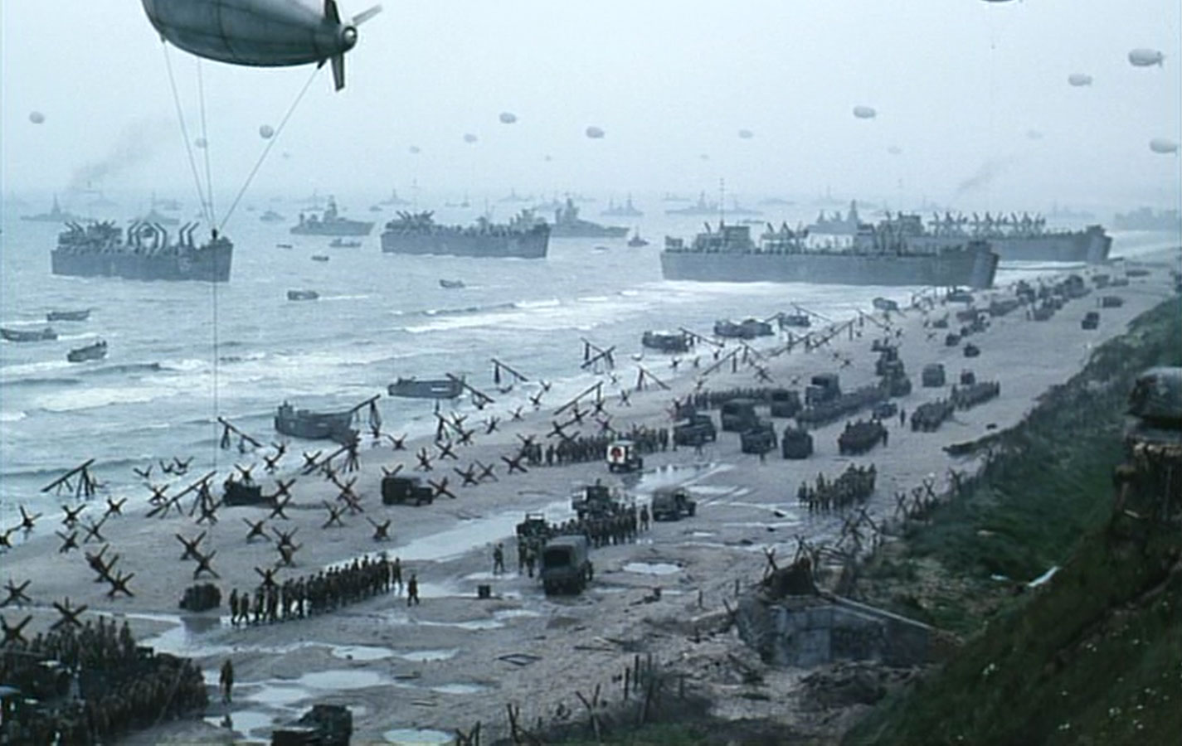

Slide 15
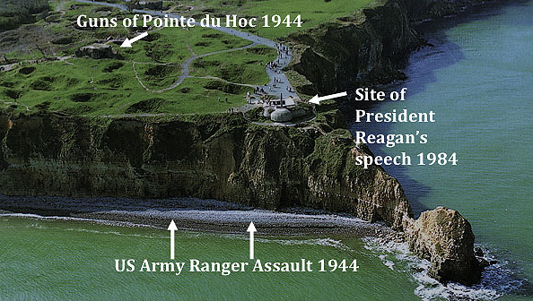
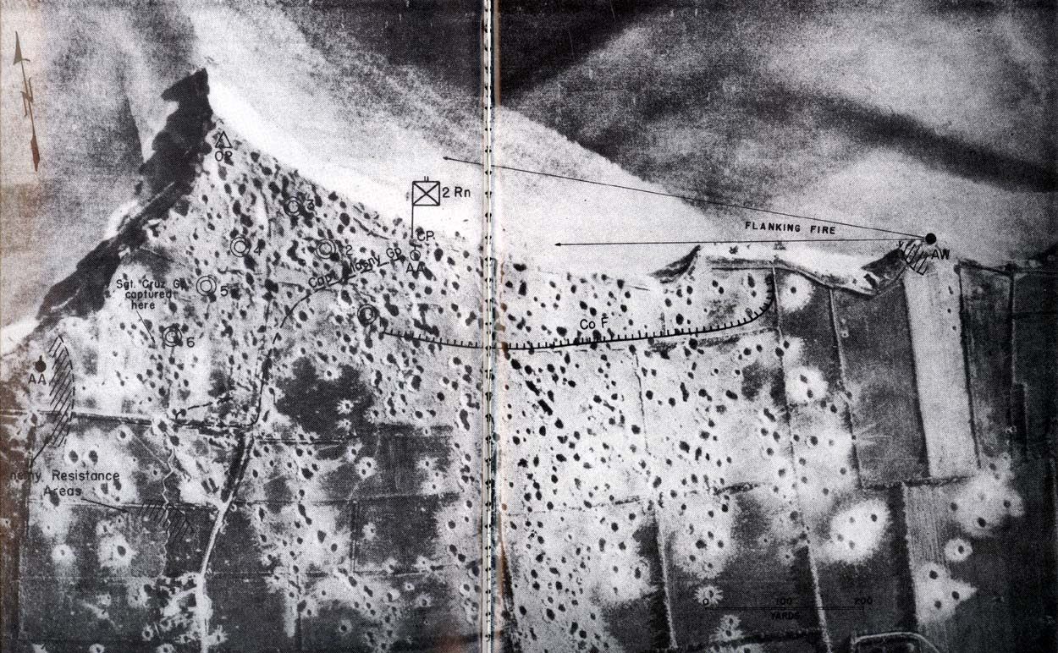

Slide 16
Activity
What did D Day stand for?
When did it occur? Add this to your timeline
What was the significance of D Day?
If D Day was unsuccessful, what do you think would have happened to Britain and the Allies? To Germany?

Slide 17
Resources
Band of Brothers – mini-series - Is a 10 part mini-series about the US 101st Airborne division that parachuted into Normandy on June 6th 1944 and their fights against the German’s as they pushed further into the Reich. It is based on the interviews of the surviving soldiers from D-Day. Band of Brothers is also a book.
Saving Private Ryan – movie – Is about a company of men asked to go find and bring back Private Ryan who has lost all his brothers in the war. Starting at the Omaha beach it follows there soldiers throughout Germany occupied France. Staring Tom Hanks and Matt Damon
This interactive map shows six key stages of the Normandy invasion and push into Germany. Open up real life accounts with survivor interviews and footage of the battle or location, or read the extra information http://ddaytovictory.ca/?ref=hl#/SceneIndex/0

