Slide 1
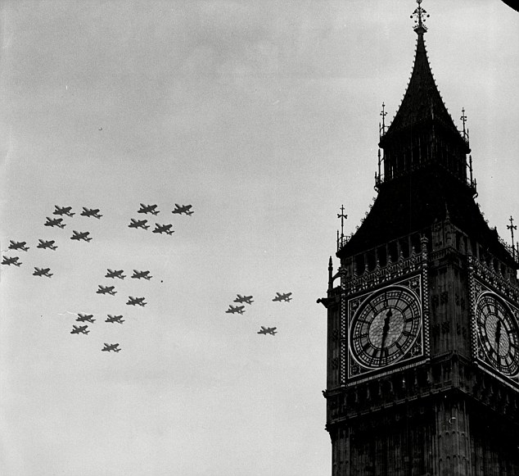
“The Battle of France is over. The Battle of Britain is about to begin."
Winston Churchill, 1940

Slide 2
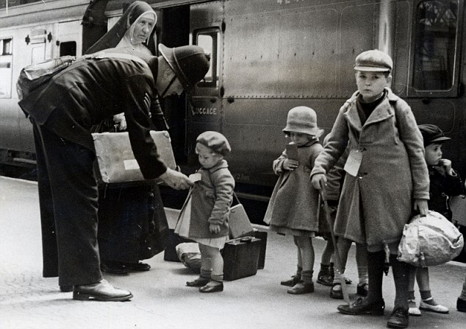
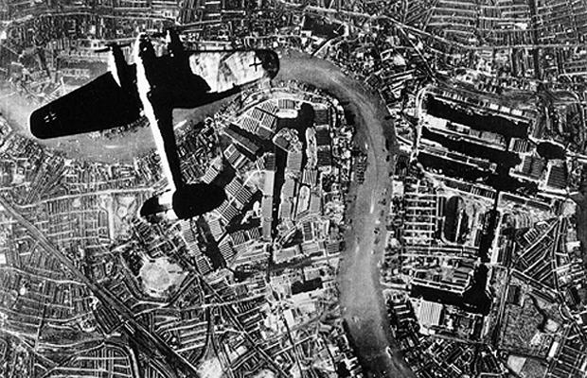
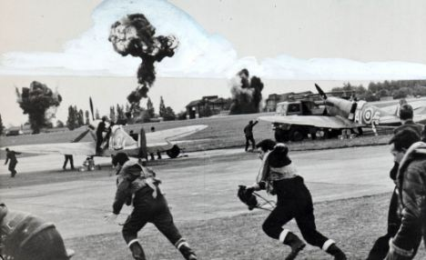
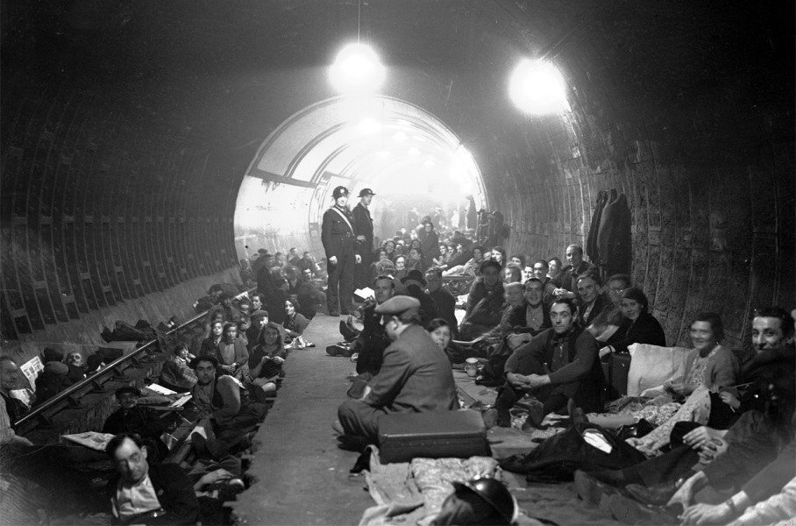
Connect the photos together – what is the link?

Slide 3
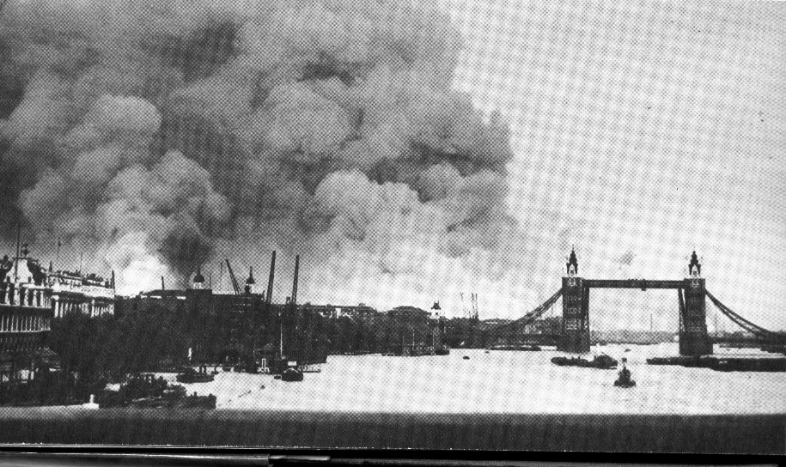
The Battle of Britain
Who and when? The Battle of Britain was between the German Air Force (Luftwaffe) and the British Royal Air Force (RAF) from July 10th 1940 until May 1941.
Why? After France surrendered in June 1940, Hitler turned his attention and war machine to the one last beacon of democracy and resistance left in Europe - England. Hitler planned to gain control of the skies before invading mainland England with the Wehrmacht (Army).
What happened? For 10 months the German Luftwaffe attacked British air fields, factories, harbours, military bases and eventually cities. The Luftwaffe drop over 18,600 tonnes of bombs on British cities which resulted in the death of 18,629 men, 16,201 women and 5,028 children - almost half of them in London. One million London homes were damaged and their residents forced to seek shelter in the London Underground.
Notes:
Hyperlink - Apocalypse
35:02 to 35:31 – Hitler is proclaimed

Slide 4
Map of airfields in England and France
Hermann Goring, the Luftwaffe Commander, promised Hitler that they would neutralise the British RAF and have ‘air superiority’ meaning Operation Sea Lion could go ahead before Christmas – the invasion of England.

Slide 5
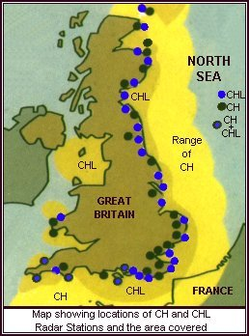
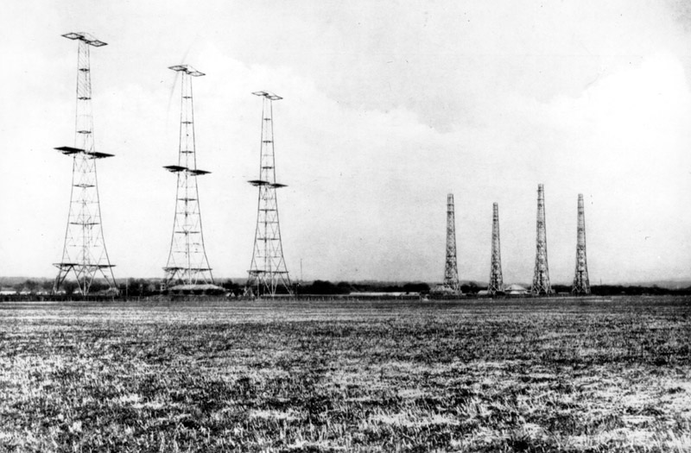
British Technology
One area of improvement that resulted from WW2 was the advancement in technology. For the British it was radar – spotting the enemy before they reached Britain.
They got so good at it they could detect the Luftwaffe leaving the air fields in Northern France.

Slide 6
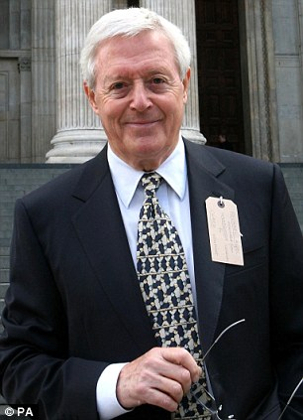
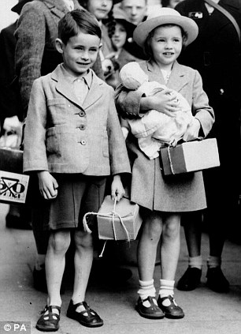
Michael Aspel 2009 Michael Aspel 1939
The Chronicles of Narnia
Notes:
Narnia
Show 0:40 to 1:40
Apocalypse
Hyperlink the children name or photo – 35:45 to 37:55

Slide 7
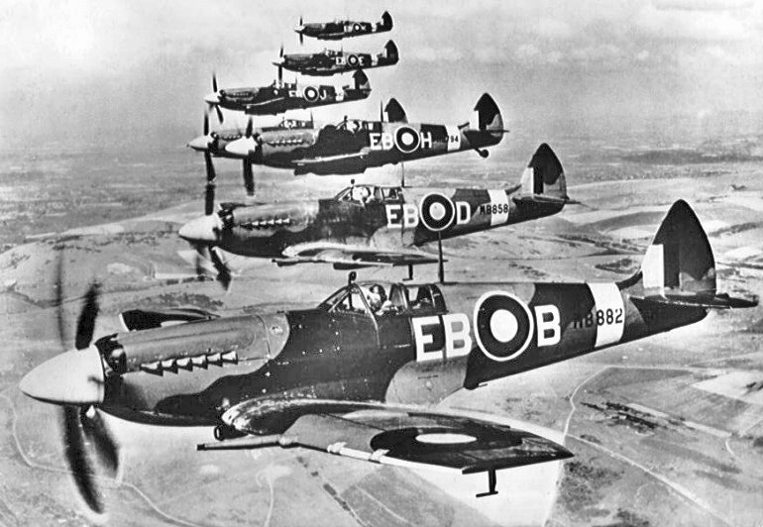
Churchill’s Inspirational Speech
Churchill made a speech on August 20th 1940 to unite the British public and comment on the importance of the youthful British RAF.
Do you think this is true? Why does he put such an emphasis on it?
Notes:
Hyperlink - Churchill’s speech
Play 0:00 to 0:26 and 2:41 to 3:19

Slide 8
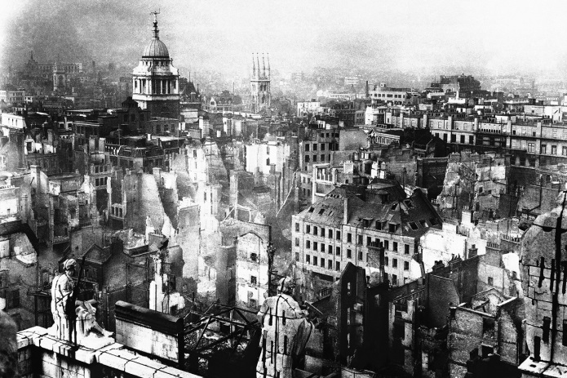
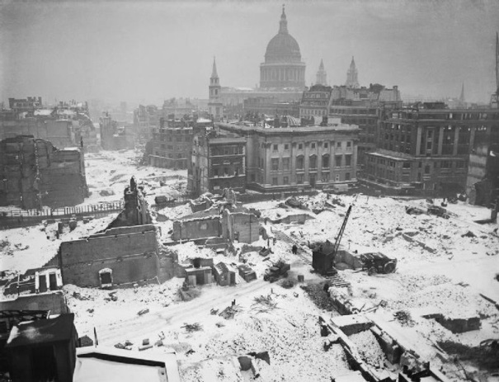
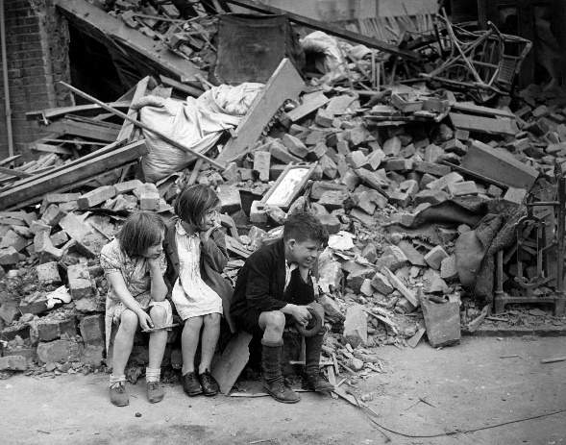
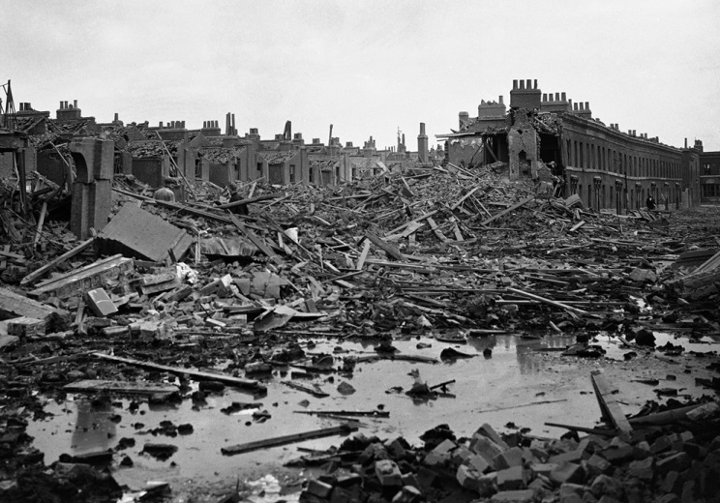
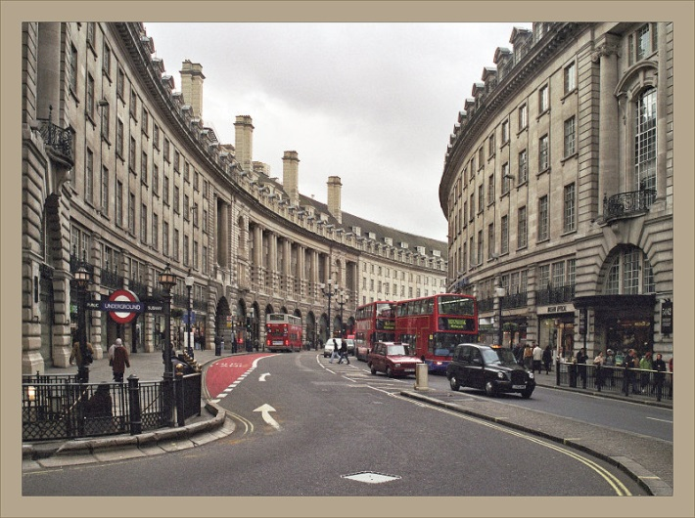
The Blitz
What happened? The Blitz refers to the daily air battles and raids over London from September until November 1940. For 57 consecutive nights from September 7th 1940 London was bombed resulting in devastating damage and thousands of deaths.

Slide 9
The Blitz
Where? The main target was London as it was the heart of England however many other industrial cities were devastatingly bombed such as Liverpool, Covington, Newcastle and Portsmouth.

Slide 10
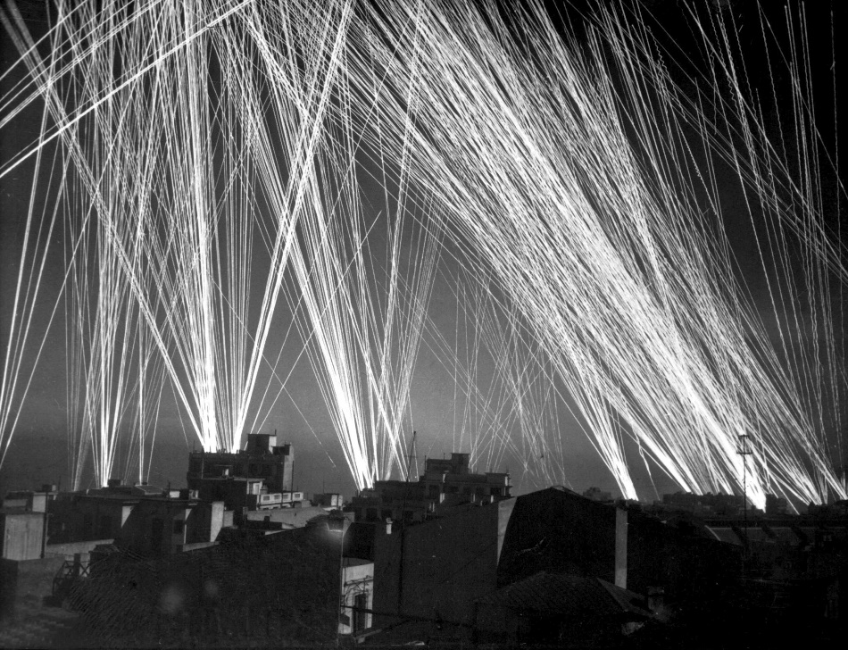
The Blitz
Why? The first bombing of London was a mistake as a squadron of bombers went off course and dropped their bombs over Londoners. This caused public outrage and Churchill’s anger resulted in retaliation by the British bombing Berlin, Germany.
Hitler was furious as Hermann Goring had promised him that no Allied plane would ever fly over the Reich (Germany). Hitler’s response was to bomb English cities until they surrendered in despair and exhaustion. Hitler’s intention was to break the morale of the British people so that they would pressure Churchill into negotiating. However, it had the opposite effect as it brought the English people together to face a common enemy.
Notes:
Apocalypse
40:51 to 44:04
https://www.youtube.com/watch?v=zMAZ_dhxlds

Slide 11
How many bombs were dropped over London you may ask?
After seeing this you may ask;
- How did they not surrender?
How was St. Paul’s not destroyed?
Where did everyone sleep in safety?
Was everyone hit or were there a lot of ‘near misses’?
Notes:
Click the title for the link

Slide 12
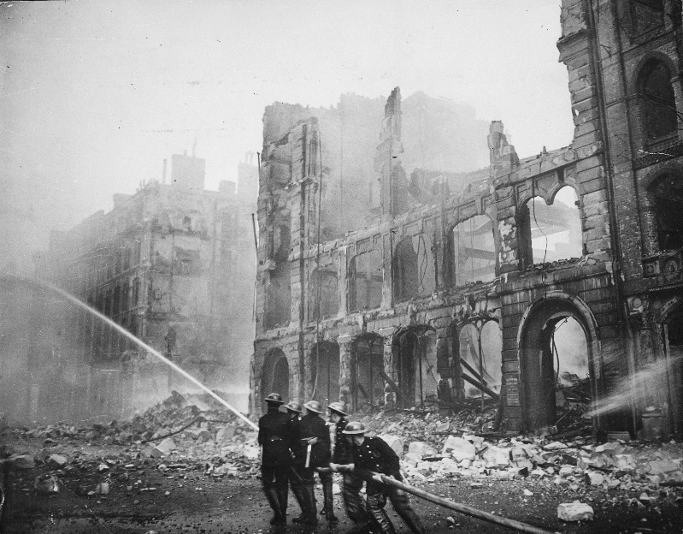
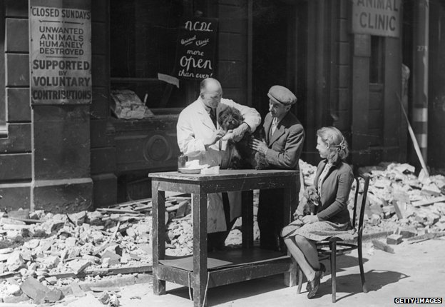
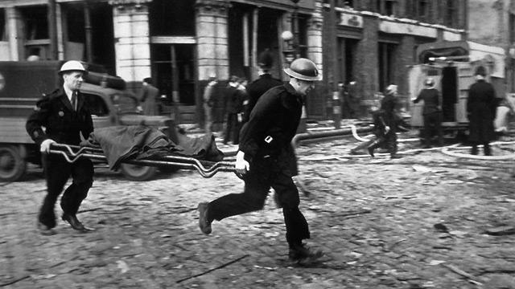
How did Churchill unite England?
Common enemy – Germany
Attitude - Dunkirk Spirit
Living and working together
Symbol of survival and divine
support – St. Paul’s

Slide 13
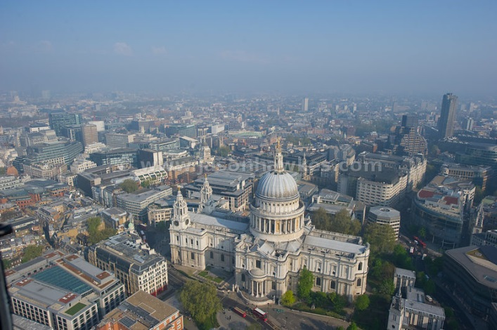
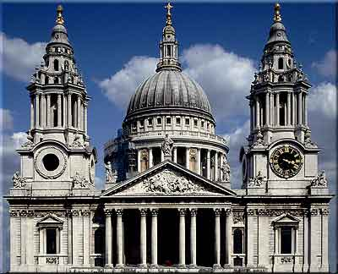
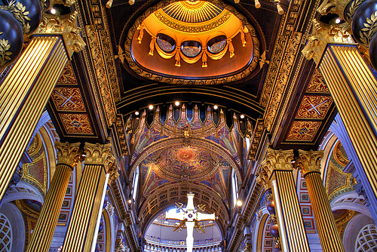
St. Paul’s Cathedral (2015)
“Every cause needs a symbol or an icon, and St. Paul's provided just that”
St. Paul’s Cathedral in the heart of London stood strong in the heat of fire and bombing by the German Luftwaffe from July 1940 to May 1941.

Slide 14
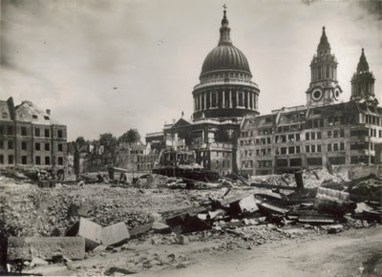
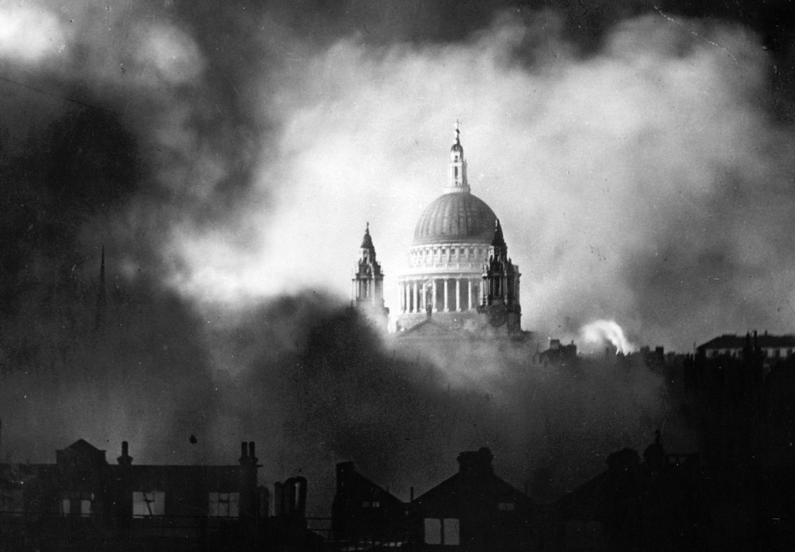
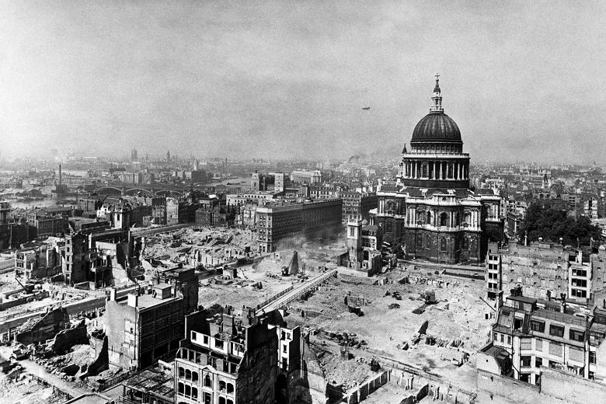
St. Paul’s Cathedral (1940)
"Remembering the escape of St. Paul's… It seemed that here was the finger of God surrounded by the folly of men”
“I do not think that any of us will forget what St. Paul's with its dome and cross meant in the darkest days of war. It seemed then a daily miracle that it should survive; that it did survive was a daily hope and inspiration and a symbol that the Christian way of life should not perish”

Slide 15
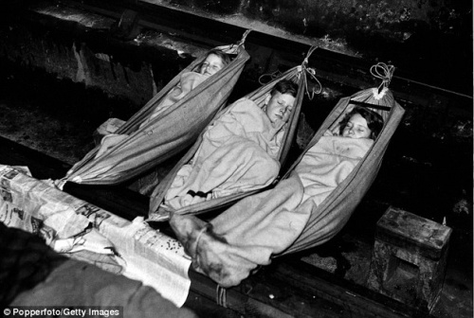
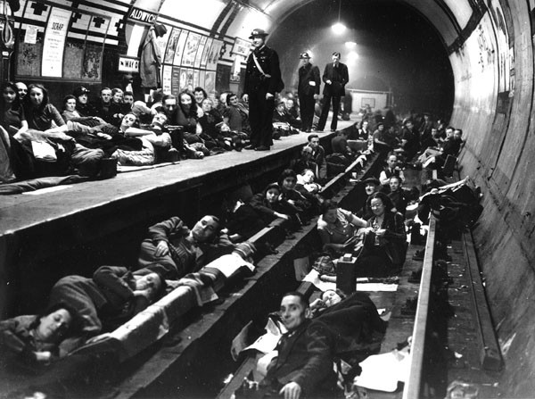
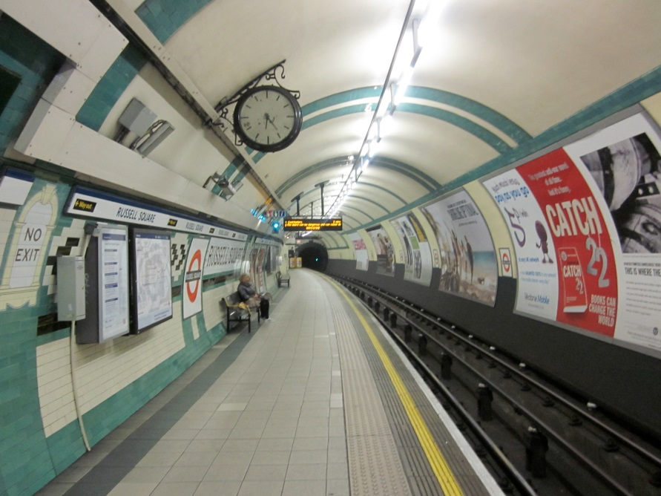
London Underground
150,000 Londoners a night Londoners to the London Underground for safety during the Blitz
Notes:
Hyperlink top left – Apocalypse – 40:51 to 44:04

Slide 16
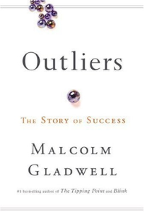
The ‘Near Misses’
Popular writer Malcolm Gladwell wrote about the Battle of Britain and how Hitler’s aim was to create fear and panic to set in but instead a culture of near misses occurred. By this he means that night after night the London population was bombed but most people survived these ‘near misses’ to live and fight another day.
After a few days/week/month of these bombs dropping incredibly close to the population they became used to the nightly raids and sleeping in the London Underground. This resulted in a belief that they were ‘lucky’ or ‘protected’ and a confidence boost to continue about their everyday lives. Gladwell states that these ‘near misses’ create a numbness to the situation as you get so used to fearing for your life every night that it becomes routine. This routine, determination, resolve and Churchill’s inspiration helped fuel the ‘Dunkirk Spirit’ and the never give up attitude of the British people.

Slide 17
How did the Battle of Britain end?
In May 1941, after 10 months of bombing England cities and countryside, Hitler finally stopped. Hitler’s resolve to invade Britain had been tested and the British public had withstood everything he could throw at them.
His failure to capture England meant he had to act quickly before Churchill brought the United States into the war. Hitler was about to break his alliance with Russia and he needed all the manpower he could muster.
Notes:
Apocalypse
Hitler’s future plans
Show 45:07 to 45:50

Slide 18
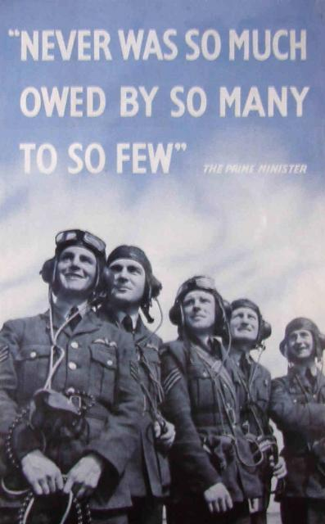

Slide 19
Extra
WW2 child evacuees reunite after 70 years; http://www.dailymail.co.uk/news/article-1210474/Two-thousand-WW2-children-evacuees-reunite-70-years-later.html
“History will be kind to me — for I intend to write it.” – Winston Churchill arguing against those who thought he was stubborn and making the wrong decisions.

